Slide 1

Deloitte
Training
2015
FOUNDATION TRAINING
Java Basics, Overview of Eclipse IDE

Slide 2
Java

Slide 3
Day 1

Slide 4
Objectives of Day 1
At the end of this module, you will be able to:
Explain Java architecture
Explain Java features
Writing simple Java code
Explain various operators and type casting
An overview of Eclipse IDE.

Slide 5
Java Features
Secure
Robust
Portable
Object Oriented
Multithreaded
Simple
Java features
Platform Independent
Architecture Neutral
High Performance
Dynamic
Distributed

Slide 6
contd..
Simple – very easy program structure and few key words.
Object Oriented – Java practices all Object programming concepts to the core viz.. abstraction, encapsulation, inheritance, polymorphism.
Platform independence – java program execute from JVM and not connected directly to any OS.
Architecture Neutral – The system features of java e.g. memory requirements remain same irrespective of CPU being 16 – bit or 32 bit.
Secure – Java offers security at levels of compilation, execution. Provides an API called java.security.
Robust – java does strict type checking, offers exception handling to prevent application crash.
Portability – the feature using which user can transport the java code to any machine and execute without re–compilation. Also aids reusability.
Distributed – Java provides APIs to develop distributed applications using client–server, multi–tiered architecture.
Dynamic – Java provides ready made utilities for dynamic memory allocation for objects.

Slide 7
Terminologies
JVM – Java Virtual Machine: contains files and tools that can be used
JDK – Java Development Kit: contains files and tools that can be used to develop programs, applications, etc;
JRE – Java Runtime Environment: contains files and tools that are used to execute programs, applications viz.. javac, java, appletviewer.
Byte code verifier – verifies the byte code for any errors
Class loader – a program that loads the class file into the JVM
JIT Compiler – Just-In-Time compiler, compiles the class file.
JVM – Java Virtual Machine: contains files and tools that can be used
JAR – Java Archive: is a package file format typically used to aggregate many Java class files and associated metadata and resources (text, images, etc.) into one file to distribute application software or libraries on the Java platform.

Slide 8
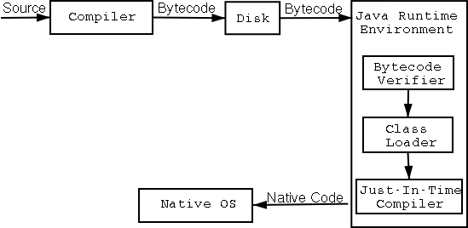
contd..
General program structure.
Java is compiled and interpreted. This is possible because of the concept of ByteCode.

Slide 9
contd..
Java is case sensitive.
Variables
Character set called as Unicode.
Naming
Scope & Life time – program elements have following scopes.
block
method
class and subclass
package
Note : Though blocks can be nested, its not possible to declare a variable to have the same name as one in an outer scope.
Type conversion and casting
Comments – single line and multi line comments.

Slide 10
Java Environment
Java Environment setup involves setting up of environment variables viz.. classpath.
CLASSPATH is an environment variable instructs the,
Java compiler javac.exe to locate class files to be imported.
JVM class loader to find the classes that are directly or indirectly invoked, including the system classes.
Setting the CLASSPATH variable
Windows : SET CLASSPATH= to set the CLASSPATH variable. E.g. SET CLASSPATH= C:\jdk1.5.0_06\bin
Linux : Modify the .bash_profile (hidden) file as follows:
CLASSPATH=<classpath1>:<installation_path>/bin
export CLASSPATH
OR export CLASSPATH=<classpath1>:<installation_path>/bin\

Slide 11
Java versions
Version | Features
1.0 | Initial release
1.1 | Inner classes; RMI, JDBC;
1.2 | New keyword – strictfp; Swing graphical API integrated into the core classes; Sun's JVM was equipped with JIT Compiler.
1.3 | RMI was modified to support optional compatibility with CORBA; JNDI included in core libraries.
1.4 | New keyword – assert; 64 bit support; Due to exception chaining, exceptions can encapsulate original lower–level exception; Internet Protocol ver – 6 support non-blocking; Image I/O API for reading and writing images; Integrated XML parser and XSLT processor; Integrated security and cryptography extensions ; Java Web Start included

Slide 12
contd..
1.5 | Generics; Autoboxing; Annotations; Collections; Enumerations; auto stub generation for RMI;
1.6 | Enhanced support for Web services.

Slide 13
Data Types and Variables
Category | Data type | Memory Size | Default Value
Numeric | byte | 1 | 0
 | short | 2 | 0
 | int | 4 | 0
 | long | 8 | 0L
 | float | 4 | 0.0f
 | double | 8 | 0.0d
Character | char | 2 | ‘\u000’
 | String |  | null
Boolean | boolean |  | false

Slide 14
contd..
Java supports a few special escape sequences for char and String literals:
\b backspace,
\t tab,
\n line feed,
\f form feed,
\r carriage return,
\” double quote,
\‘ single quote, and
\\ backslash.

Slide 15
Operators
Sl.No | Category | Operation | Operators
1. | Unary | Increment | ++
 |  | Decrement | --
2. | Binary | Relational | >, <, >=, <=, ==, !=
 |  | Logical | &&, ||, !
 | Note : Java supports Short Circuit logical operations.
 |  | Arithmetic | %, /,*, +,-
 |  | Assignment | =
3. | Bitwise | Bitwise Logical | &,|,~,^, &=, |=,^=,
 |  | Bitwise Shift | >>, <<, >>>, >>=,<<=,>>>=

Slide 16
contd..
Sl.No | Category | Operation | Operators
4. | String | Concatenation | +
5. | Memory | Allocation | new
6. | Compound | Arithmetic | %=, /=, *=, +=, -=
7. | Ternary | Conditional | ?:

Slide 17
Control statements
Conditional
if
if…else
else..if ladder
switch
Repetitive
while loop
do..while
for loop
Enhanced for loop
for(type itr var : collection)
{ statements ; }
Key words
continue
break
default
Nesting
Nesting is permitted in all the statements.

Slide 18
Implementing Classes in Java
Syntax
class <classname> {
<body of the class>
}
where,
class is the keyword used for creating a class,
<classname> is the name of the class, and
<body of the class> consists of declaration of attributes and methods.

Slide 19
contd..
Diagrammatic representation of object definition
class Sample
{
int a;
float b;
void input()
{ a=10; b=25.75; }
void output()
{ System.out.println(a);
System.out.println(b); }
}
{ Sample obj;
obj = new Sample();
}
Object reference
obj
Object instance
a
b

Slide 20
contd..
Object execution sequence –
Declaration
Execution
Garbage collected.
Object life cycle –
Declaration
Initialization
Input
Process
Output
Garbage collected

Slide 21
Features of class members
Qualifiers
static – instance variables, methods, blocks, objects, class
final – instance variables, methods, objects, class
transient – instance variables, objects
volatile – instance variables, objects.
synchronized – methods, blocks, objects.
abstract – methods, class.
Note – a data member can be static and final; but final assumes greater priority.
Accessibility – Java provides for four access specifiers viz..
public
protected
private
default

Slide 22
Methods in Classes
Name of the method
Method
Definition
Type of object or primitive type that the method returns
Body of the method
List of parameters

Slide 23
contd..
Syntax
<returntype> <methodname> (<type1> <arg1>, <type2> <arg3,…)
{
<set of statements>
}
where,
returntype is the data type of the value returned by the method,
<methodname> is the user-defined name of the method, and method’s parameter list is a set of variable declarations.

Slide 24
contd..
class Book {
String bookName;
String authorName;
int nopages;
boolean available;
void isAvailable() {
if(available == true)
System.out.println("The Book is available");
}
…
method

Slide 25
contd..
Methods are accessed using dot notation.
Object whose method is called is on the left of the dot, while the name of the method is on the right.
For Example,
Obj.isAvailable();
Java provides class methods, which are similar to instance methods.
Class method declaration is preceded with a static keyword

Slide 26
contd..
class Book {
String bookName;
String authorName;
int nopages;
boolean available;
}
static void isAvailable() {
if(available == true)
System.out.println("The Book is available");
}
Book objBook = new Book();
objBook.isAvailable();
…..
Dot notation

Slide 27
Constructors
Method invoked whenever an instance of a given class is created.
Same name as the class and no return type.
Java allocates memory for the object, initializes the instance variables and calls the constructor methods.
Two types of constructors
Parameterized constructors
Implicit constructors

Slide 28
contd..
Sdate(int m,int d,int y) {
month=m;
day=d;
year=y;
System.out.println("The Date is " + m + "/" + d + "/" + y + ".");
}
public static void main(String args[])
{
Sdate S1,S2;
S1=new Sdate(11,27,1969);
S2=new Sdate(3,3,1973);
}
Parameterized Constructor
Example of Parameterized Constructors

Slide 29
contd..
Example of Implicit Constructors
Sdate()
{
month=11;
day=27;
year=1969;
}
public static void main(String args[])
{
Sdate S1,S2;
S1=new Sdate();
S2=new Sdate();
}
No arg Constructor

Slide 30
contd..
public static void main(String[] args) {
Book objBook = new Book("CoreJava", "Albert", 45, true)
User objUser = new User();
objUser.getBookStatus(objBook);
}
Book(String book, String author, int pages, boolean status) {
bookName = book;
authorName = author;
nopages = pages;
available = status;}
class User {
void getBookStatus(Book objBook) {
objBook.isAvailable();
}
}
Demonstrate: Example 1

Slide 31
Access Specifier
Information hiding is one of the most important features of OOPs.
Reasons for information hiding are:
Changes made to any implementation details will not affect code that uses this class.
Prevents accidental erasure of data by users.
The class is easy to use.
Access Specifiers
private
protected
public
Default / package specific

Slide 32
contd..
public
private
Accessible to members and non members of the class
Accessible only to members of the class
protected
default
Accessible to members of the class and members of its subclass
Accessible to members of the class in the same package

Slide 33
Method
Method Modifiers
static
final
synchronized
abstract

Slide 34
static members
static instance variables belong to the class and not to the object.
static variables can be accessed using class-name , objects and through static methods.
static methods are used to access the static variables.
static methods can also be accessed using class-name, objects and through other static methods.
Commonly used to have the count of objects.

Slide 35
Method Overloading
Method Overloading
More than one methods having same name in the class
Methods have different argument list
Argument List varies in type and / or numbers

Slide 36
contd..
Usage of methods with same name.
Argument lists varying in type and / or number.
void display() {
System.out.println("No arguments are there for displaying !!");
}
void display(double count) {
System.out.println("Inside the display(double) method :" + count);
}
void display(double count) {
System.out.println("Inside the display(double) method :" + count);
}
void display(int num, int num1) {
System.out.println("The two integer numbers are :" + num + " " + num1);
}
public static void main(String [] arg) {
int count = 25;
DisplayNumber dispObj = new DisplayNumber();
dispObj.display();
dispObj.display(10 , 20);
/* No method with a single argument of type int exists,
int value is automatically promoted to double
*/
System.out.println("Invoking the display(double) method"
+ "with an int variable: " + count);
dispObj.display(count);
dispObj.display(25.5);
}
Method accepting no argument is invoked
Method accepting two int arguments is invoked
Method accepting a double argument is invoked
Method accepting a double argument is invoked
Demonstration: Example 4

Slide 37
Methods with variable arguments
Need for methods with variable arguments
class Sample
{
public int multiply(int a, int b)
{ return a*b; }
public int multiply(int a, int b, int c)
{ return (a*b)*c; } public int multiply(int a, int b, int c, int d)
{ return (a*b)*(c*d); } }

Slide 38
contd..
Variable number of arguments
The ... syntax tells the compiler that a variable number of arguments will be used, and that these arguments will be stored in the array referred to by v.
in calling method, vaTest( ) is called with different number of arguments, including no arguments at all; ( in such a case the length of the array is zero).
the variable-length parameter must be the last parameter declared by the method and only one variable-argument parameter is allowed.
a method can have “normal” parameters along with a variable-length parameter.

Slide 39
this Keyword
Used inside any instance method to refer to the current object.
The value of this refers to the object on which the current method has been called.
The this keyword can be used where a reference to an object of the current class type is required.

Slide 40
Example of this Keyword
class pixel {
int x,y;
void init (int x, int y)
{
this.x = x;
this.y = y;
}
}
public static void main (String args[])
{
pixel p = new pixel();
p.init (4,3);
}
Reference to an object
The program initializes x = 4 and y = 3.

Slide 41
contd..
Nested class – Class can be a member of another class. Such a class is called as Nested class.
Nested classes are of two types – static and non static.
The non static nested class is called as Inner class.
Anonymous class – An inner class can be anonymous.
Anonymous class –
Defined at location where
Combine the process of definition and instantiation in single step.

Slide 42
What is Eclipse?
Eclipse is as an integrated development environment (IDE) for Java.
Eclipse is created by an Open Source community.
Eclipse is used as a development environment for Java or Android applications.
It is the leading development environment for Java.
Eclipse project is governed by the Eclipse Foundation.

Slide 43
Getting started
Eclipse requires an installed Java Runtime.
Eclipse contains its own development tools, e.g. Java compiler. so it's requires only JRE.

Slide 44
Install Eclipse
Install Eclipse download the package "Eclipse IDE for Java Developers" from the website:
http://www.eclipse.org/downloads
Unpack it to a local directory.
The download is a "zip" file and unzip it.
Use a directory path which does not contain spaces in its name, as Eclipse sometimes has problems with that.
After unpacking the download, Eclipse is ready to be used.
No additional installation procedure is required.

Slide 45
Eclipse Platform
Eclipse is a multi-language software development environment comprising an integrated development environment (IDE) and an extensible plug-in system.
It can be used to develop applications in Java and, by means of various plug-ins, other programming languages.
The Eclipse SDK (which includes the Java development tools) is meant for Java developers.

Slide 46
Platform Components
Name | Description
Ant | Eclipse/Ant integration
Core | Platform runtime and resource management
CVS | Platform CVS Integration
Debug | Generic execution debug framework
Releang | Release Engineering
SWT | Standard Widget Toolkit
Team/Compare | Generic Team and Compare support frameworks
Text | Text editor framework
User Assistance | Help system, initial user experience, cheat sheets etc.
UI | Platform user interface
Update | Dynamic Update/Install/Field Service

Slide 47
Licensing
The Eclipse Public License (EPL) is the fundamental license under which Eclipse projects are released.
Some projects require dual licensing, for which the Eclipse Distribution License (EDL) is available.

Slide 48
Versions
Implementation | Version
Callisto | 3.2
Europa | 3.3
Ganymede | 3.4
Galileo | 3.5
Helios | 3.6
Indigo | 3.7
Juno | 3.8 and 4.2
Kepler | 4.xx

Slide 49
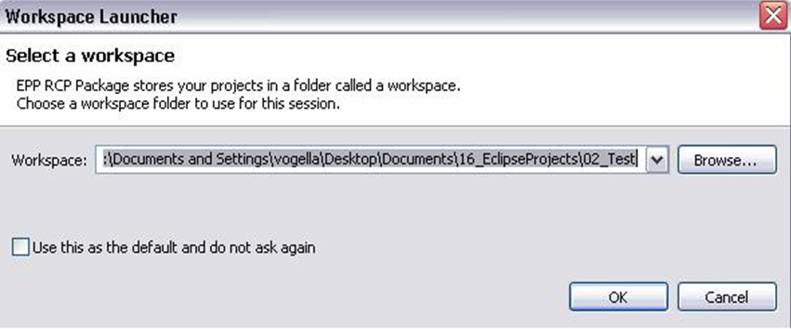
Using Eclipse
To start Eclipse double-click on the file eclipse.exe.
The system will prompt you for a workspace.
Select an empty directory and press Ok

Slide 50
What is the workspace?
Workspace is the physical location (file path) you are working in.
You can choose the workspace during startup of Eclipse or via the menu ( File → Switch Workspace → Others) .
All your projects, source files, images and other artifacts will be stored and saved in your workspace.

Slide 51
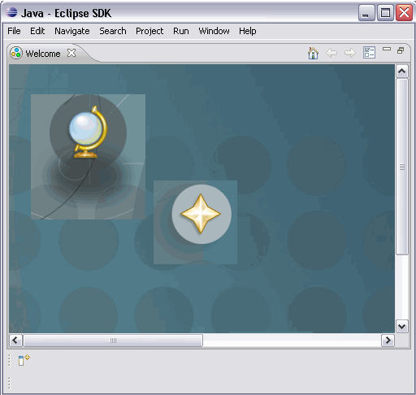
Start Eclipse
Eclipse will start and show the Welcome page.
Close the welcome page by pressing the "X" beside "Welcome"

Slide 52
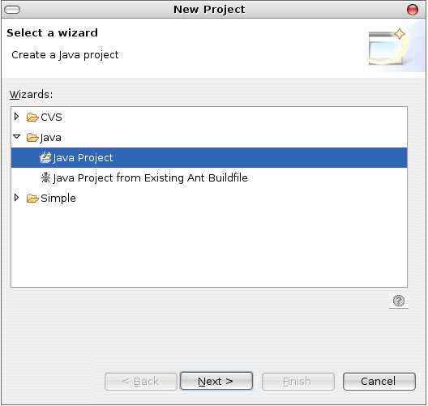
Using Eclipse
Select File->New->Project....from project dialouge box
You should see Java Project appear.
Click on Java Project
Click on Next

Slide 53
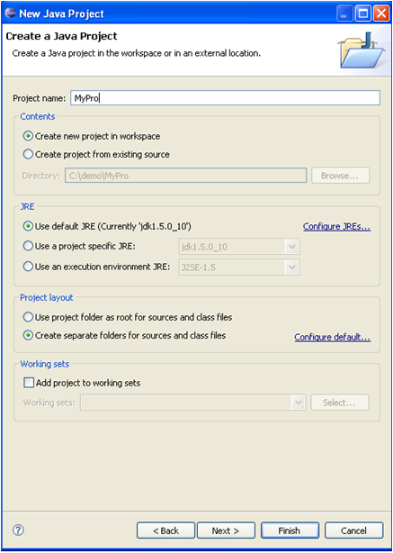
contd..
Give your project a name
Click Finish

Slide 54
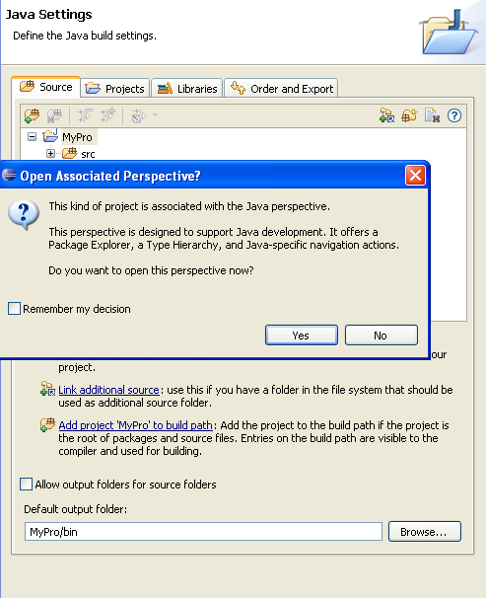
contd..
If it asks you to switch to the Java Perspective, say yes

Slide 55
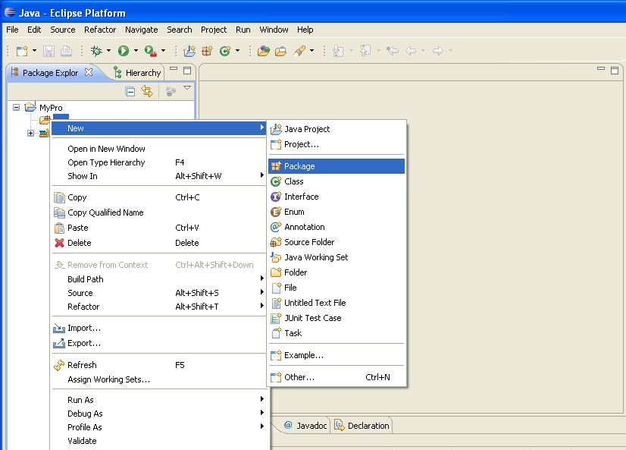
Create package
Select the folder src, right click on it and select
New → Package

Slide 56
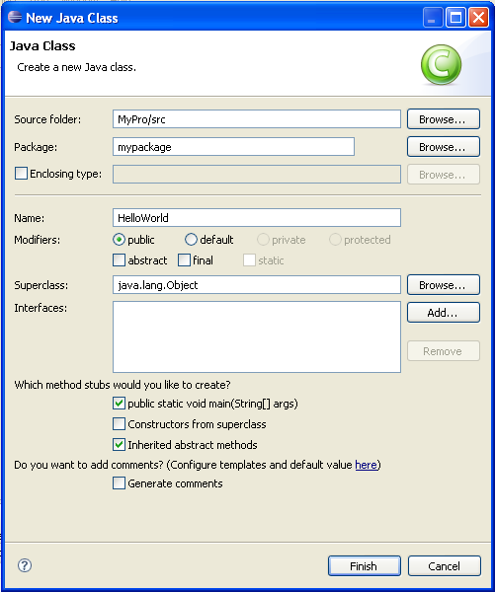
Adding new classes/ files to the project
To add a new class go to the project click
File–>New–> Class.
The New Class Dialog will appear
Click on the option to create a main() method

Slide 57
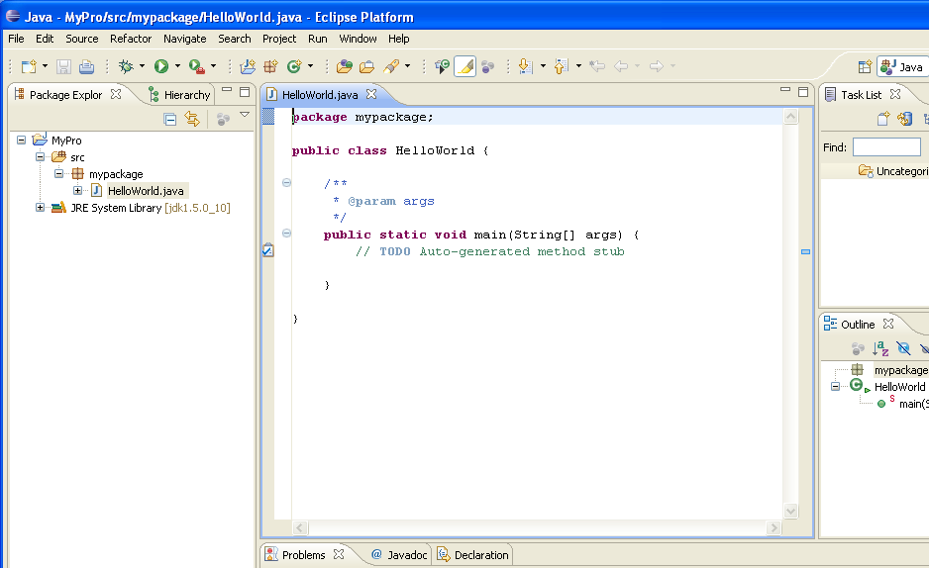
contd..
After adding new class your window should look like this.

Slide 58
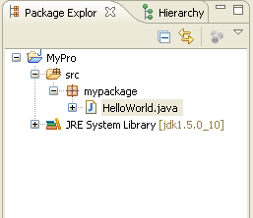
Java Perspective and Package Explorer
On the left hand side, this perspective shows the "Package Explorer" View
By using this we can browse our Java projects.
Select the components you want to work on via double-click.
Notes:
In the middle you have the open Editor for a Java source file.
To the right and below the editor area you find more Views which were considered useful by the developer of the perspective.
For example the "Console" view shows the output of System.out statements in your code.

Slide 59
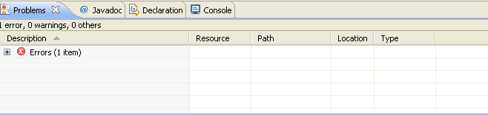
Problems view
To view the problems in your project you can use the "Problems" View which is part of the standard Java Perspective

Slide 60
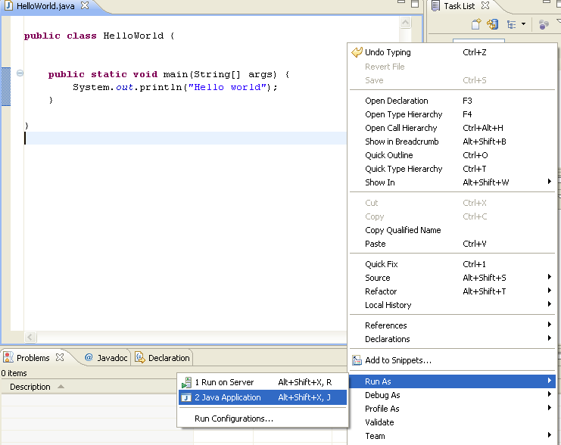
Run the Project in Eclipse
Right click on your Java class and select Run-as → Java application

Slide 61
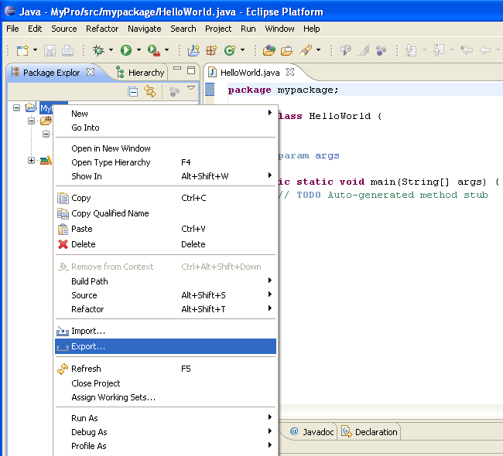
Creating jar files
Right click on your project and select Export

Slide 62
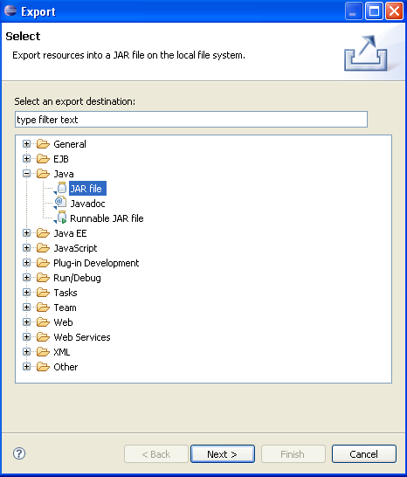
contd..
Select JAR file
Click on next

Slide 63
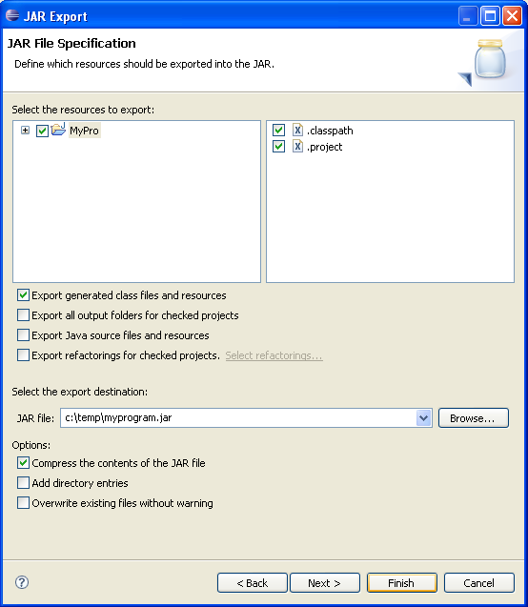
contd..
Select your project
Maintain the export destination and a name for the jar file and give the jar file name as myprogram.jar
Press finish. This creates a jar file in your selected output directory

Slide 64
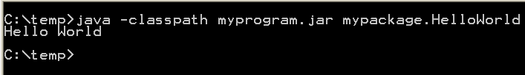
Run your program outside Eclipse
Open a command prompt.
To run this program you need to include the jar file in your classpath.
Switch to your output directory, by typing cd path. For example if your jar is located in c:\temp type cd c:\temp.

Slide 65
Content Assist
Content assistant allows you to get input help in an editor. It can be invoked by pressing CTRL+Space
For example type syso in the editor of a Java source file and then press CTRL+Space. This will replace syso with System.out.println("").
If you have a reference to an object, for example the object obj of the type Student and need to see it's methods, type person. and press CTRL+Space.

Slide 66
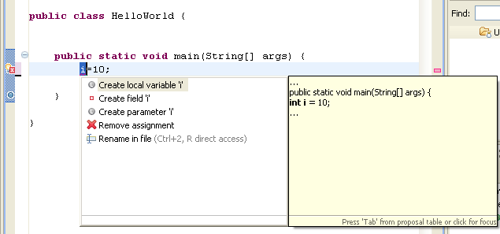
Quick Fix
Whenever Eclipse detects a problem, it will underline the problematic text in the editor. Select the underlined text and press CTRL+1 to see proposals how to solve this problem.
For example type i=10; If i is not yet defined, Eclipse will highlight it as an error
Select the variable and press CTRL+1, Eclipse will suggest creating a field or local variable

Slide 67
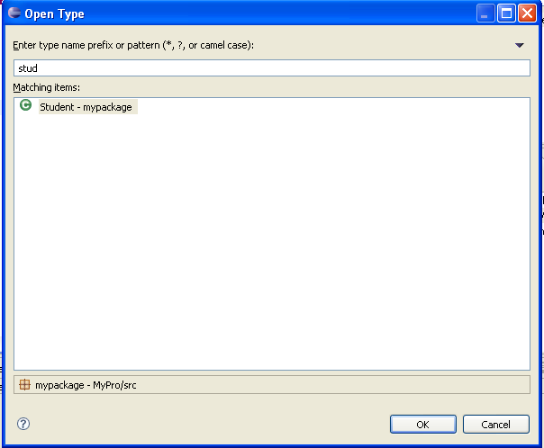
Opening a class
Classes can navigate in your project via the "Package Explorer" View.
Alternatively, you can press CTRL+Shift+T. This will show a dialog in which you can enter the class name to open it.

Slide 68
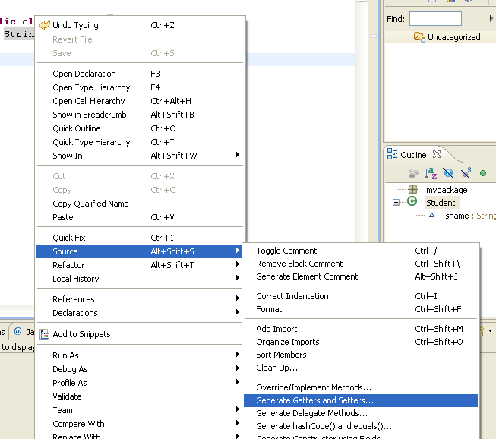
Generating code
Using eclipse we can generate code automatically this will save significant time during development.
For example, if student class contains sname as a property we can generate setters and getters method
Click on Generate setters and getters
Right click on the project via source

Slide 69
Refactoring
Using refactoring we can restructure the code without changing his behavior.
For example renaming a Java class or method is a refactoring activity.
For example you can select your class, right click on it and select Refactor → Rename to rename your class or method.
Eclipse will make sure that all calls in your Workspace to your your class or method will also be renamed.

Slide 70
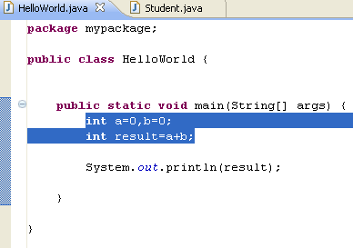
contd..
For the next examples change the code of "HelloWorld.java" to the following.
Mark the code and right click and select refactoring -> Extract method

Slide 71
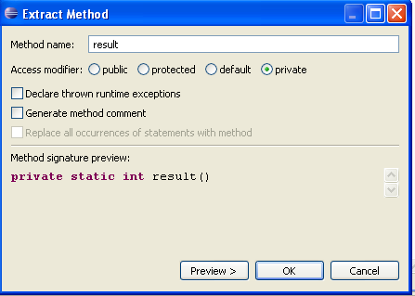
contd..
Give method name as result

Slide 72
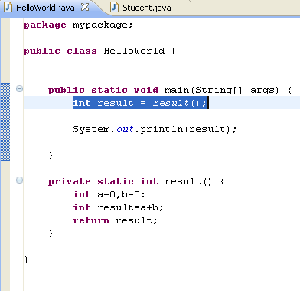
contd..
After refactoring class should look like the following

Slide 73
Eclipse Shortcuts
Navigation
Shortcut | Description
CTRL+SHIFT+R | Open / Search for resources, e.g. files
CTRL+SHIFT+T | Open / Search for Types
CTRL+E | Allows to select an editor from the currently open editors
CTRL+F8 | Shortcut for switching perspectives
Ctrl-PageUp/PageDown | Switch to previous /next editor
F3 | Go to declaration of this variable
CTRL+SHIFT+P | Go to the matching bracket

Slide 74
contd..
Search
Running programs.
Shortcut | Description
Ctrl+ | Go to the next problem / error
Ctrl- | Go to the previous problem / error
F4 on a variable | Show type hierarchy
CTRL+J,CTRL+K | Incremental search, find next
CTRL+SHIFT+G | Search for references in the workspace
Shortcut | Description
Ctrl+F11 | Run last launched
Alt+Shift+X-J | Run current selected class as java application

Slide 75
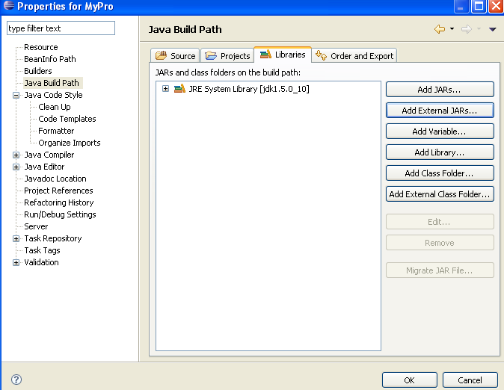
Using jars (libraries)
Using jars (libraries)
Adding a library (.jar ) to your project
Right click on the project select properties->java build path->add external jar files

Slide 76
Add the Javadoc for a jar
Download the Javadoc of the jar and put it somewhere in your filesystem.
Later Javadoc can be added to a jar
Open the Java Build Path page of a project via Right click on a project → Properties → Java Build Path. On the "Libraries" tab expand the library's node, select the "Javadoc location" attribute and press Edit.
Enter the location to the file which contains the Javadoc.

Slide 77
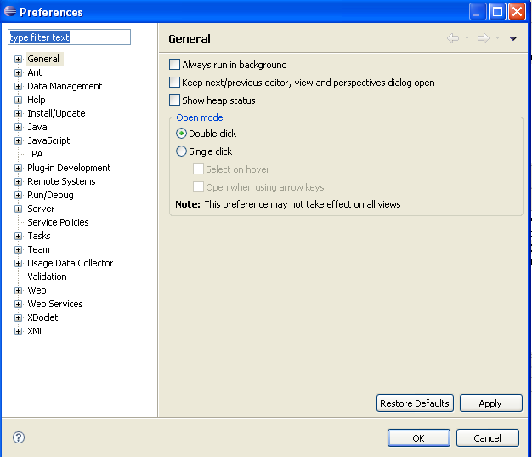
Efficiency Settings
Eclipse Preferences
Eclipse IDE can be controlled via the Preference Settings.
Select Window → Preferences to open the preference settings dialog. You can use the filter box to search for specific settings

Slide 78
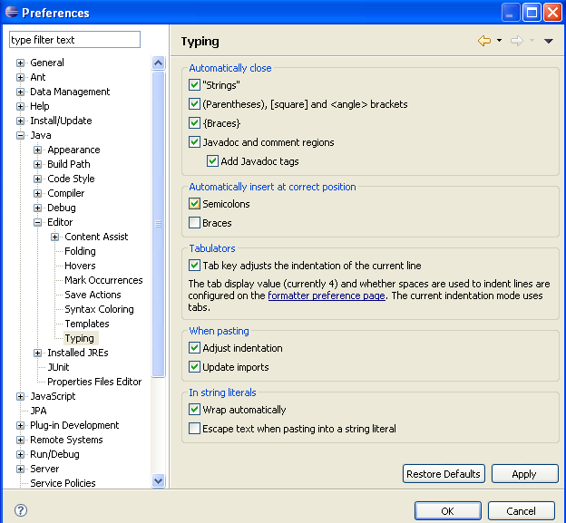
Automatic placement of semicolon
Eclipse can make typing more efficient by placing semicolons at the correct position in your source code.
section "Automatically insert at correct position”, enable the "Semicolons" checkbox
In the Preference setting select Java → Editor → Typing. In the

Slide 79
Java Application Build Steps
Compiling all source files
Building war files
Compiling unit test codes
Java Application Build
Managing the project structure
Configuring all the dependent files
Notes:
Faculty Notes:
Building a Java web application is very hard and can be a very tedious task. Typical build steps are as follows:
* Compiling all source files. Copying all class files to a temporary directory.
* Compiling unit test source codes and then run unit tests. Stopping the build process if a unit test fails.
* Transferring other required files (xml, properties, etc) to the temporary directory.
* Copying all the web content files.
* Building the war file.
Participant Notes:
We have created several Java applications till now in the course. We managed the build steps manually till now. However, when we deal large enterprise applications building the application and taking care of the dependencies could become very tedious
Transition:
Let’s have a look at some of the common issues

Slide 80
Issues
Common Issues
Configuring multiple jars
Managing Dependencies
Managing Project structure
Deploying
Building and testing modules
Notes:
Faculty Notes:
Imagine a large application with different modules eg: order, inventory etc and for some reason we want to create a separate war file for each of the modules. And then there is a common module which all of these depend on which has to be created as a jar and included in all war files.
While building a real time application we should take care of multiple modules, sequence in which modules need to be built and deploy it to various servers/environments like testing, production etc. Performing this manually would be difficult. Thus, in scenarios like this we use a build tool which helps us automate the process.

